Slide 1
Republic of the Philippines Province of Pangasinan Municipality of Calasiao MUNICIPAL HEALTH OFFICE
DENGUE FEVER CASES IN CALASIAO
January to December 10, 2010

Slide 2
INFORMATION:
A total of 101 suspect cases of Dengue Fever were reported in Calasiao, Pangasinan from January to December 10, 2010 this year, an increase of 32 cases from the last report ending October 15, 2010.However, there may be other cases not yet reported. The reporting on Dengue Fever cases is dependent on data coming from both government and private hospitals. We also include cases seen in our health facilities where Dengue Fever cases are managed and treated at home although the number is quite few. There have been two deaths reported, the first last August 22 , a 28 year old female from Barangay Dinalaoan, and the second last October 3, a 15 year female student from Barangay Buenlag, resulting in a relatively high case fatality rate of 1.98%.

Slide 3
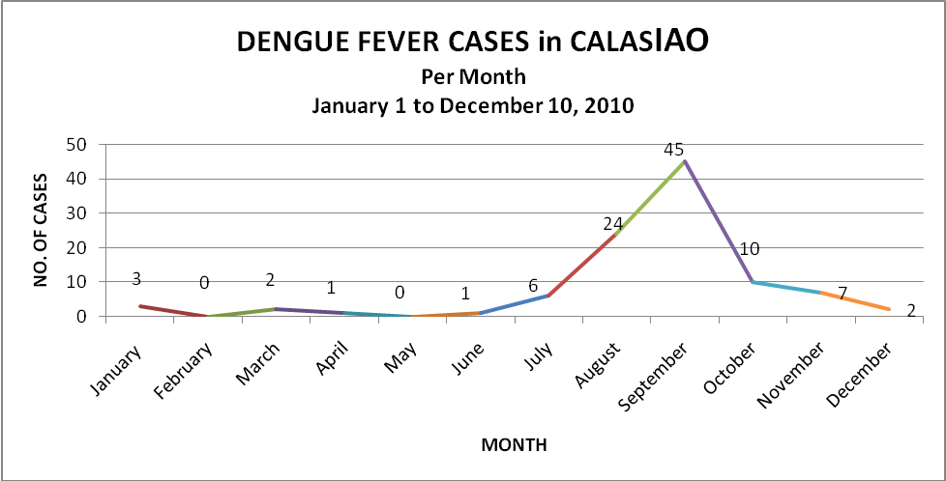

Slide 4
For the same period, there were 58 cases last year, thus the cases reported for this year is now 174 % higher than last year. Compared to 2008 which had a total 191 cases, this year is lower by 54%. The next graph below will show, just like in the previous years, the present trend is on its way down, however, in both precious years, cases were no longer reported by the last week of September, while this year, cases are still being reported up to the time of this report. This reflects the concern of the Department of Health that indeed, Dengue Fever is now endemic and is present all year-round. This fact should be a major concern for our local community, requiring continuous efforts and try to come up with new approaches in the anti-Dengue Fever activities being implemented.

Slide 5
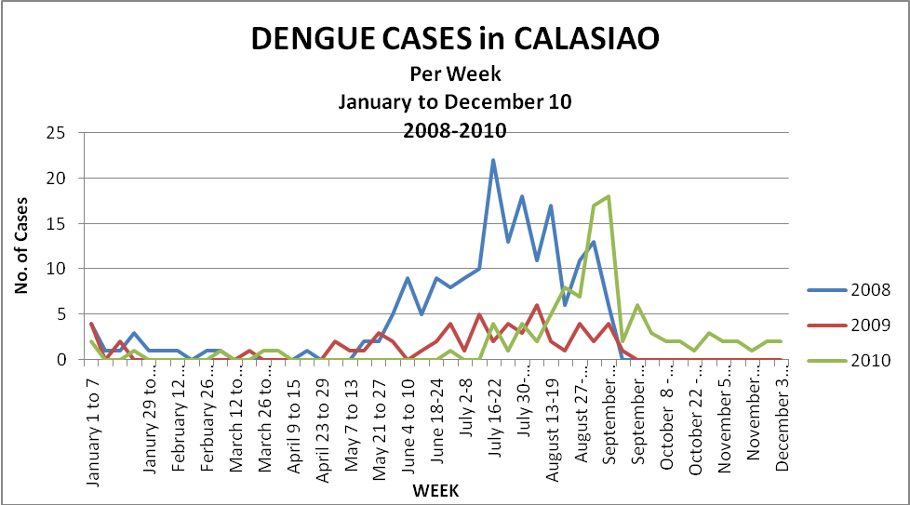
Of the 101 Dengue Fever suspect cases reported, forty eight (48) are males and fifty three (53)) are females with the youngest at less than a month old and the oldest at 47.

Slide 6
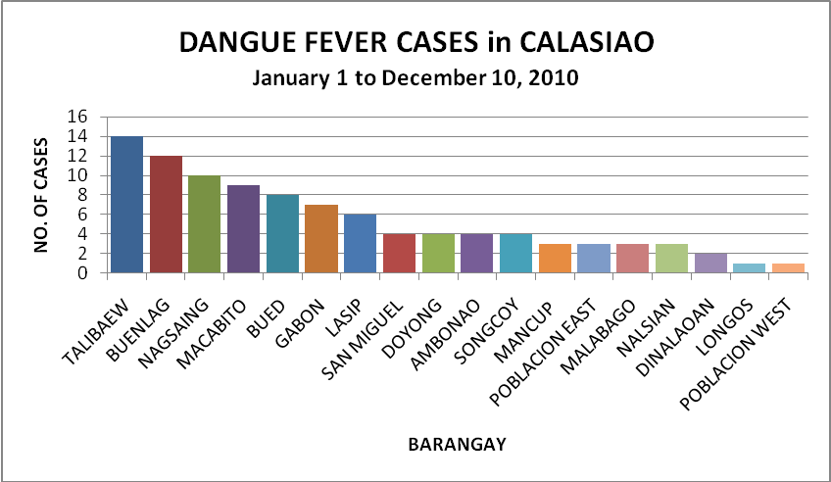
The number of barangays affected has remained the same from the last report dated October 15, 2010, still 18 barangays of the 24 barangays of Calasiao. The most significant increase for the past two months was observed in Barangays Nagsaing, Talibaew and Buenlag. Other barangays with increase in cases are Macabito, Poblacion East, Bued, San Miguel. and Mancup.

Slide 7
BARANGAY | Jan. | Feb. | Mar. | Apr. | May | Jun. | Jul. | Aug. | Sept. | Oct. | Nov. | Dec. | TOTAL
Ambonao | 1 |  |  |  |  |  | 1 | 1 | 1 |  |  |  | 4
Bued |  |  |  |  |  |  |  | 2 | 4 | 2 |  |  | 8
Buenlag |  |  |  |  |  |  |  | 6 | 4 | 2 |  |  | 12
Dinalaoan |  |  |  |  |  |  |  | 2 |  |  |  |  | 2
Doyong | 1 |  |  |  |  |  |  |  | 2 | 1 |  |  | 4
Gabon |  |  |  |  |  |  | 1 | 3 | 3 |  |  |  | 7
Lasip |  |  | 1 |  |  |  |  | 1 | 3 | 1 |  |  | 6
Longos |  |  | 1 |  |  |  |  |  |  |  |  |  | 1
Macabito |  |  |  |  |  |  |  | 1 | 6 | 2 |  |  | 9
Malabago |  |  |  |  |  |  | 1 | 2 |  |  |  |  | 3
Mancup |  |  |  |  |  |  |  |  | 3 |  |  |  | 3
Nagsaing |  |  |  |  |  |  |  |  | 4 |  | 5 | 1 | 10
Nalsian |  |  |  |  |  |  | 1 | 1 | 1 |  |  |  | 3
Poblacion East |  |  |  |  |  |  | 1 |  |  |  | 1 | 1 | 3
Poblacion West | 1 |  |  |  |  |  |  |  |  |  |  |  | 1
San Miguel |  |  |  |  |  |  | 1 | 1 | 1 | 1 |  |  | 4
Songkoy |  |  |  |  |  |  |  | 2 | 2 |  |  |  | 4
Talibaew |  |  |  | 1 |  |  |  |  | 10 | 2 | 1 |  | 14
Unknown |  |  |  |  |  | 1 |  | 1 | 1 |  |  |  | 3
 | 3 | 0 | 2 | 1 | 0 | 1 | 6 | 23 | 45 | 11 | 7 | 2 | 101

Slide 8
The anti-Dengue activities have been in place at the start of the year, continuous improvements are being done as the Health Office monitors the present status of the disease in the community. The Environmental Sanitation and Dengue Fever Prevention and Control consultant, Mr. Gil Parayno, has been doing the rounds of the various affected barangays and conducts lectures on the importance of cleanliness as the primary objective in the control and prevention of Dengue Fever. The staff of the Health Office, in cooperation with the barangay health workers and the barangay officials, has been conducting house to house ocular inspection of the households and their surroundings to emphasize cleaning and removal of breeding places for mosquitoes, at the same time, distributing the health advisories and conducting clean-up drives. This activity will be ongoing as health advisories are reproduced for distribution. Misting operations are also being undertaken, especially in

Slide 9
barangays with high incidence or clustering of reported cases of Dengue Fever.
RESPONSE ACTIVITIES
I. PROMOTION AND INFORMATION/EDUCATION COMMUNICATION CAMPAIGN
LGU officials
regular updates to the LCE and other officials
resources and funding from LGU for anti-Dengue activities
Propose a resolution/ordinance for the promotion of the 4 o’clock habit for implementation in the Municipality of Calasiao
Liga ng Mga Barangay
Updates to the LIGA
Involvement in clean-up drives

Slide 10
- MHO Staff
Weekly updates of Dengue cases (every Mondays and during monthly regular meetings)
Lectures on updates about Dengue Fever and as a form of information dissemination to respective catchment areas
Distribution of IEC materials
Case finding and early referral of suspected Dengue cases as well as epidemiological investigations/reporting
Barangay Health Workers
Lecture s on updates and status of Dengue cases during monthly regular meeting
Distribution of IEC materials and assistance in health education and information campaigns during community assemblies
Support group for case finding and early referral of suspected Dengue cases as well as during epidemiological investigations/reporting

Slide 11
Community Assemblies
Health education on various health programs including Dengue Fever
Done in areas where suspected Dengue Fever cases were reported and a requisite before a clean-up activity
In cooperation with the Barangay officials and BHWs
Student Affiliates Barangay Visits
Lecture s on updates and status of Dengue cases in Calasiao
Distribution of IEC materials and assistance in health education and information campaigns during Mothers’ and Purok Classes

Slide 12
II. REPRODUCTION AND DISTRIBUTION OF INFORMATION MATERIALS
Health Advisories on Dengue Fever and other diseases: to date, a total of 30 reams have been reproduced
Posters on the 4 O’Clock Habit: reproduced
Posting of Streamers
III. TECHNICAL AND LOGISTIC ASSISTANCE
Misting operation done in barangays with high incidence or clustering of reported cases of Dengue Fever
The Center for Health Development for the Ilocos Region provided reports coming from both public and private hospitals
The Provincial Health Office provided reports coming from hospitals and has provided IEC materials for reproduction

Slide 13
IV. MONITORING AND EVALUATION
Fever cases surveillance, platelet count being done at the Main Health Center laboratory
Epidemiological investigations and regular reporting
Monitoring of anti Dengue activities and evaluation of performance .
DR. JESUS ARTURO P. DE VERA DR. CRISTINA P. ESTRADA
Municipal Health Officer Rural Health Physician

